Slide 1
The Step Counter
P542 Term Project by Varun Patil (vcpatil)

Slide 2
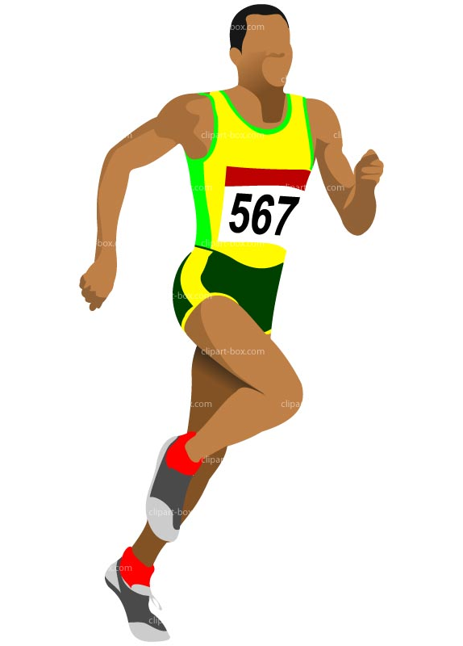
The Idea
Track the distance of the user irrespective of their speed and length of the stride
Enable tracking indoors as well as outdoors

Slide 3
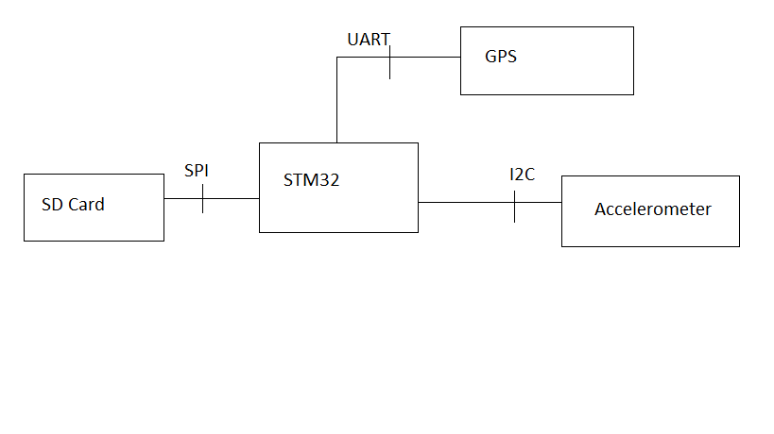
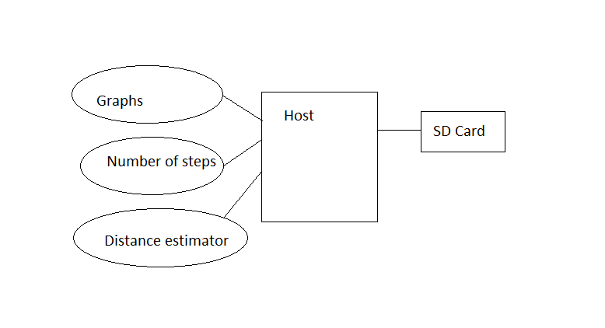
Block Diagram

Slide 4
Technical Profile
Category | Design Objective | Deliverable | Status
Power | Battery Life | The battery can last for months depending upon the frequency with which it is used.
Power | Battery Availability | The system can work on commercially available 9V battery.
User Interface | Web access | Web application should be in place to enable the user to visualize the data.
Data Logging | Information Storage | The SD card can log in a large number of data entries.
Mechanical | Environmental | The system should work fine in the temperature range of -30 C to 70 C

Slide 5
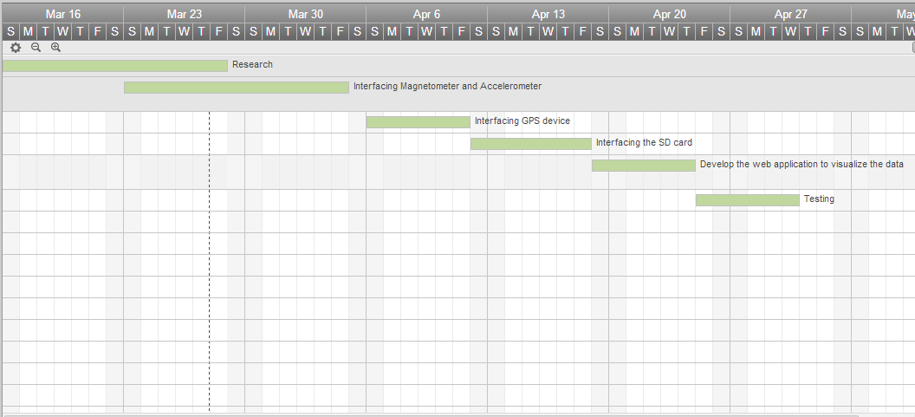
Schedule

Slide 6
Components and Cost
Component | Quantity | Cost
Battery | 1 | $4
STM32 board | 1 | $15
UART | 1 | $10
SD card | 1 | $13
GPS | 1 | $60
Accelerometer | 1 | $25

Slide 7
Future Scope
Optimized version that can be easily fitted on to the shoes

Slide 8
Thank You!

